Slide 1
Red Team vs Blue Team Capstone Engagement
Assessment, Analysis, and Hardening of a Vulnerable System By Zak Chowdhury

Slide 2
Table of Contents
This document contains the following sections:
01
Network Topology
02
Red Team: Security Assessment
03
Blue Team: Log Analysis and Attack Characterization
Hardening: Proposed Alarms and Mitigation Strategies
04

Slide 3
Network Topology
3

Slide 4
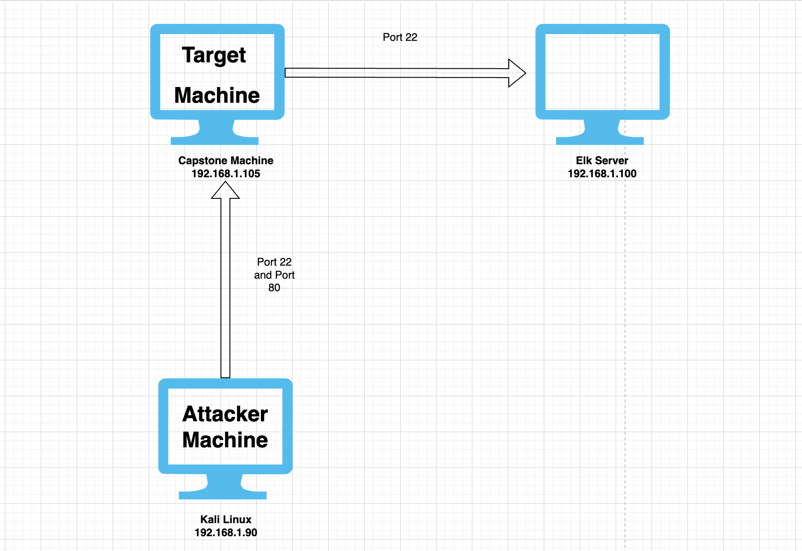
Network Topology
Network
Address Range: 192.168.1.0/24
Netmask:
255.255.255.0
Gateway:
192.168.1.1
Machines
IPv4: 192.168.1.1
OS: Windows
Hostname: Hyper V
IPv4: 192.168.1.90
OS: Linux
Hostname: Kali
IPv4: 192.168.1.105
OS: Linux
Hostname: Capstone
IPv4: 192.168.1.100
OS: Linux
Hostname: Elk Server
Monitoring
SIEM System

Slide 5

Red Team
Security Assessment
5

Slide 6
Recon: Describing the Target
Nmap identified the following hosts on the network:
Hostname | IP Address | Role on Network
Hyper-V Azure Machine | 192.168.1.1 | Host Machine
Kali Linux | 192.168.1.90 | Target Machine
Capstone | 192.168.1.105 | Attacking Machine
ELK Server | 192.168.1.100 | Monitoring/Logging Machine

Slide 7
Vulnerability Assessment
The assessment uncovered the following critical vulnerabilities in the target:
Vulnerability | Description | Impact
Open Port(s) to Public | An open port allows attackers to enter to gain open and unsecured access (e.g., port 80 – HTTP) | Confidential files and folders are exposed and easily accessible to unauthorized users
Weak Usernames and Passwords | The usernames are exactly similar to the management names and the passwords are too simple and can be infiltrated with decryption coding | In the case of a brute force attack, it is easy for an attacker to retrieve usernames and passwords and gain access to valuable information due to public accessibility
Local File Inclusion (LFI) Vulnerability | Remote vulnerability access into confidential files on an exposed machine | Attackers can gain access to critical and personal information

Slide 8
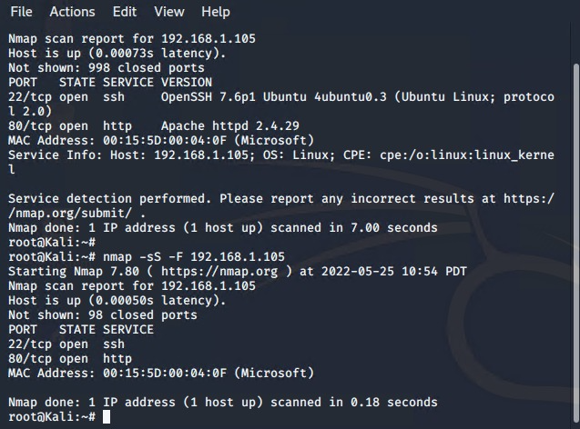
Exploitation: Open Port(s) to Public
01
02
03
Tools & Processes
Nmap
Nmap was used to scan for any open ports.
The commands that were used, but not limited to the following:
nmap -sV 192.168.1.105
nmap -sS -F 192.168.1.105
Achievements
Found out that two ports on the capstone machine were open (port 22 and port 80)

Slide 9
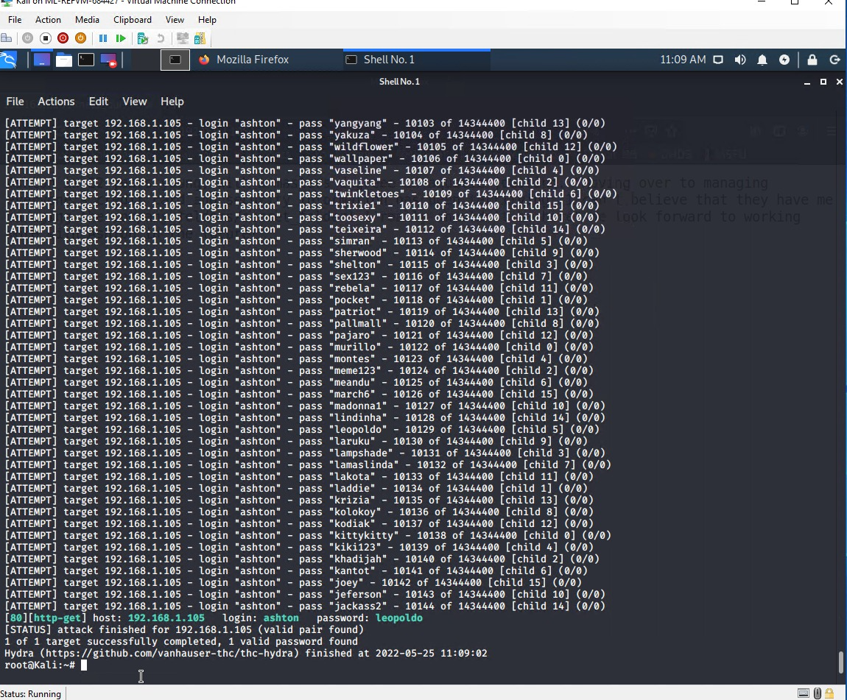
Exploitation: Weak Usernames and Passwords
01
02
03
Tools & Processes
Hydra
Used the login cracker Hydra to bruteforce Ashton’s username against the webserver’s password with wordlist files - rockyou.txt.
hydra -l ashton -P /usr/share/wordlists/rockyou.txt -s 80 -f -vV 192.168.1.105 http-get /company_folders/secret_folder
John the ripper and Crackstation
Used to break the hashed password
Achievements
Ashton’s password of “Leopoldo” was located in the password list within the VM. With Ashton’s credentials, we had full access to the hidden directories located on the webserver
Gaining Ryan’s hash and being able to decrypt with John the ripper and crackstation.com

Slide 10
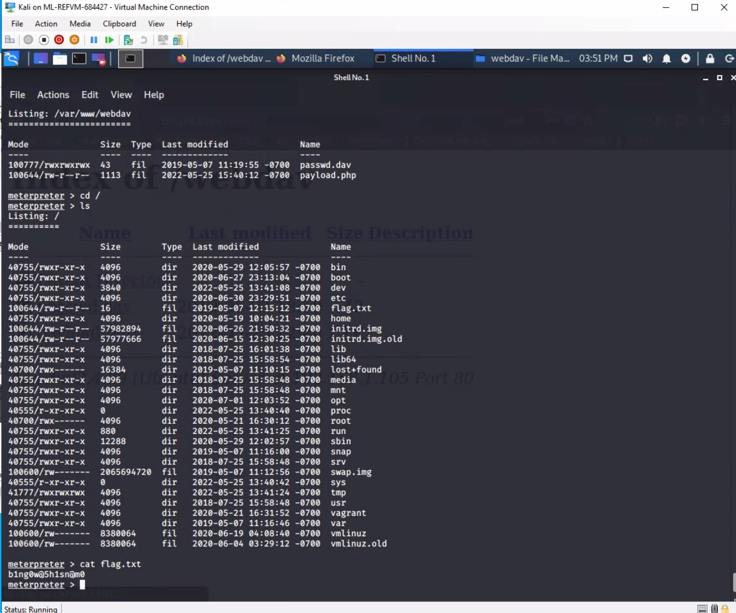
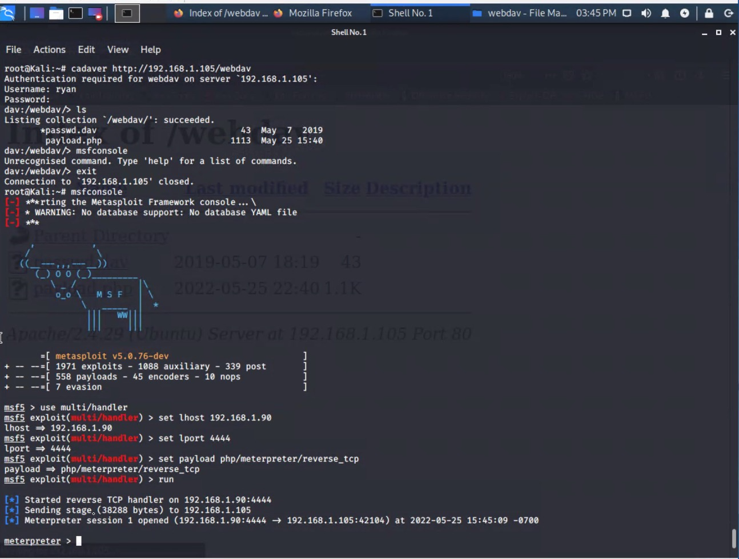
Exploitation: Local File Inclusion (LFI) Vulnerability
01
02
03
Tools & Processes
Msfvenom
Used to create the malicious script payload.php
Metasploit
Started a listener that was used to begin a meterpreter session to deliver the payload.php onto the vulnerable machine
Achievements
Successfully achived access to the machine’s shell using the multi/handler exploit and allowing us to upload the payload remotely directly on the web browser.

Slide 11

Blue Team
Log Analysis and Attack Characterization
11

Slide 12
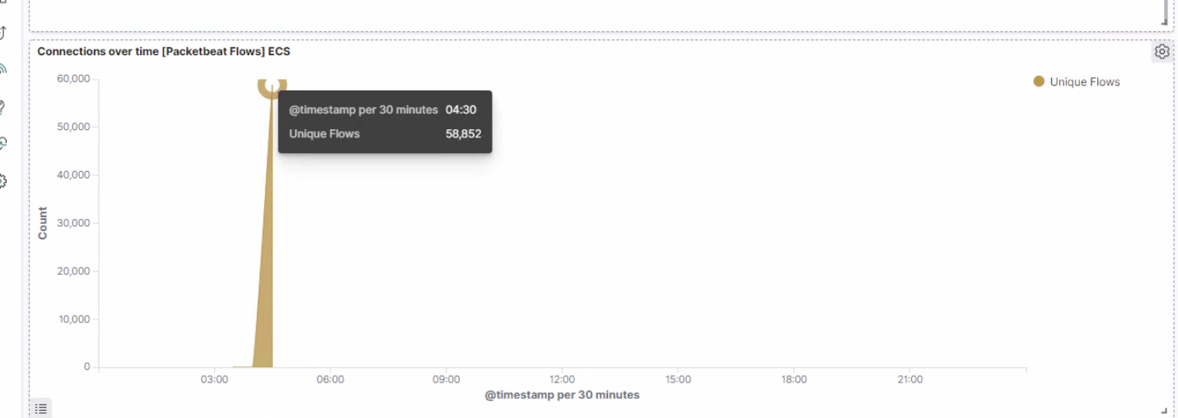
Analysis: Identifying the Port Scan
What time did the port scan occur?
The port scan occurred at 4:30
How many packets were sent, and from which IP?
58,852 packets were sent from the IP 192.168.1.90 to 192.168.1.105
What indicates that this was a port scan?
The peak in network traffic is an indicator that this was a port scan

Slide 13
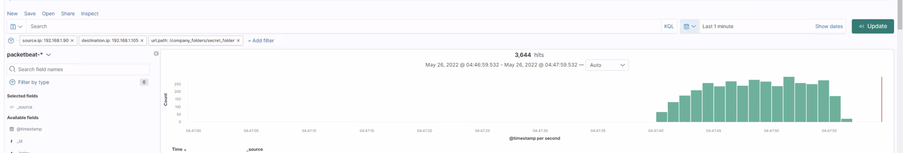
Analysis: Finding the Request for the Hidden Directory
What time did the request occur? How many requests were made?
The request occurred from 4:46 to 4:47 on May 26th and 3,644 requests were made
Which files were requested? What did they contain?
The secret_folder file was requested. It contained a hash that could be used to access the system using Ryan’s credentials
.

Slide 14
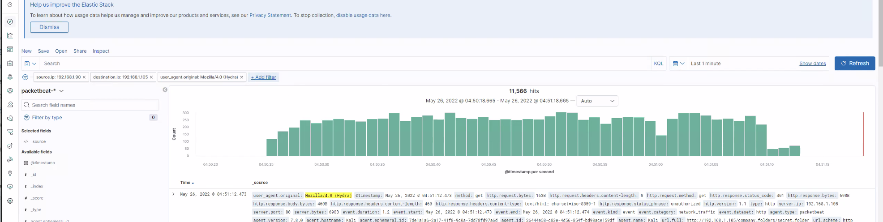
Analysis: Uncovering the Brute Force Attack
How many requests were made in the attack?
11,566 requests were made in the attack
How many requests had been made before the attacker discovered the password?

Slide 15

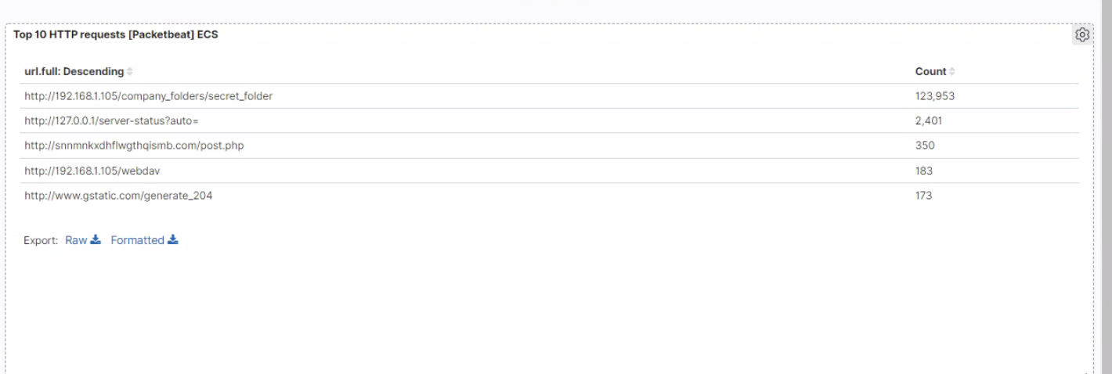
Analysis: Finding the WebDAV Connection
Answer the following questions in bullet points under the screenshot if space allows. Otherwise, add the answers to speaker notes.
How many requests were made to this directory?
183 requests were made to the WebDAV directory
Which files were requested?
The payload.php and passwd.dav files was requested

Slide 16
Blue Team
Proposed Alarms and Mitigation Strategies
16

Slide 17
Mitigation: Blocking the Port Scan
What kind of alarm can be set to detect future port scans?
An alert in place for any ports that are being scanned (less severe alerts VS more severe alerts)
What threshold would you set to activate this alarm?
The threshold that would be set to activate this alarm would be 20 scans
What configurations can be set on the host to mitigate port scans?
Use of firewalls to prevent any unfamiliar IPs from scanning
Describe the solution. If possible, provide required command lines.
Ensuring that all ports that do not need to be open are closed and that ports are regularly being monitored

Slide 18
Mitigation: Finding the Request for the Hidden Directory
What configuration can be set on the host to block unwanted access?
Blacklisting those IPS that are being accessed from when there are 10 failed attempts
Describe the solution. If possible, provide required command lines.
Policy that requires a password change every 2 months
Multi-factor authentication to be required for all users
What kind of alarm can be set to detect future unauthorized access?
An alert that will be sent out if there are multiple failed login attempts
What threshold would you set to activate this alarm?
An alert notification to be sent out after 3 failed logins within a span of 30 minutes

Slide 19
Mitigation: Preventing Brute Force Attacks
What kind of alarm can be set to detect future brute force attacks?
An alarm that alerts if there is a 404 errors
What threshold would you set to activate this alarm?
The alert to be sent when the error appears more than 10 times
What configuration can be set on the host to block brute force attacks?
Policy that locks out a user if more than 3 failed logins
Describe the solution. If possible, provide the required command line(s).
Forcing stronger passwords to be in place. 8 characters long and at least one special character, an uppercase letter, and at least one number

Slide 20
Mitigation: Detecting the WebDAV Connection
What kind of alarm can be set to detect future access to this directory?
An alarm that sets out an alert if any IP from the blacklist attempts to access the WebDAV directory
What threshold would you set to activate this alarm?
An alert to be sent if 1 IP from the blacklist attempts to access the directory
What configuration can be set on the host to control access?
Limiting the amount of users that can have access to the directory
Describe the solution. If possible, provide the required command line(s).
Scanning incoming traffic
Stronger authentication to WebDAV with passwords requirements and whitelisted IPs

Slide 21
Mitigation: Identifying Reverse Shell Uploads
What kind of alarm can be set to detect future file uploads?
An alert that is sent out if there are any suspicious extensions being added into the WebDAV folder
What threshold would you set to activate this alarm?
The alert to be sent out if there are one or more attempts
What configuration can be set on the host to block file uploads?
IPs that are on the blacklist to be blocked
Describe the solution. If possible, provide the required command line.
Ensuring that only the proper ports are open

